Slide 1

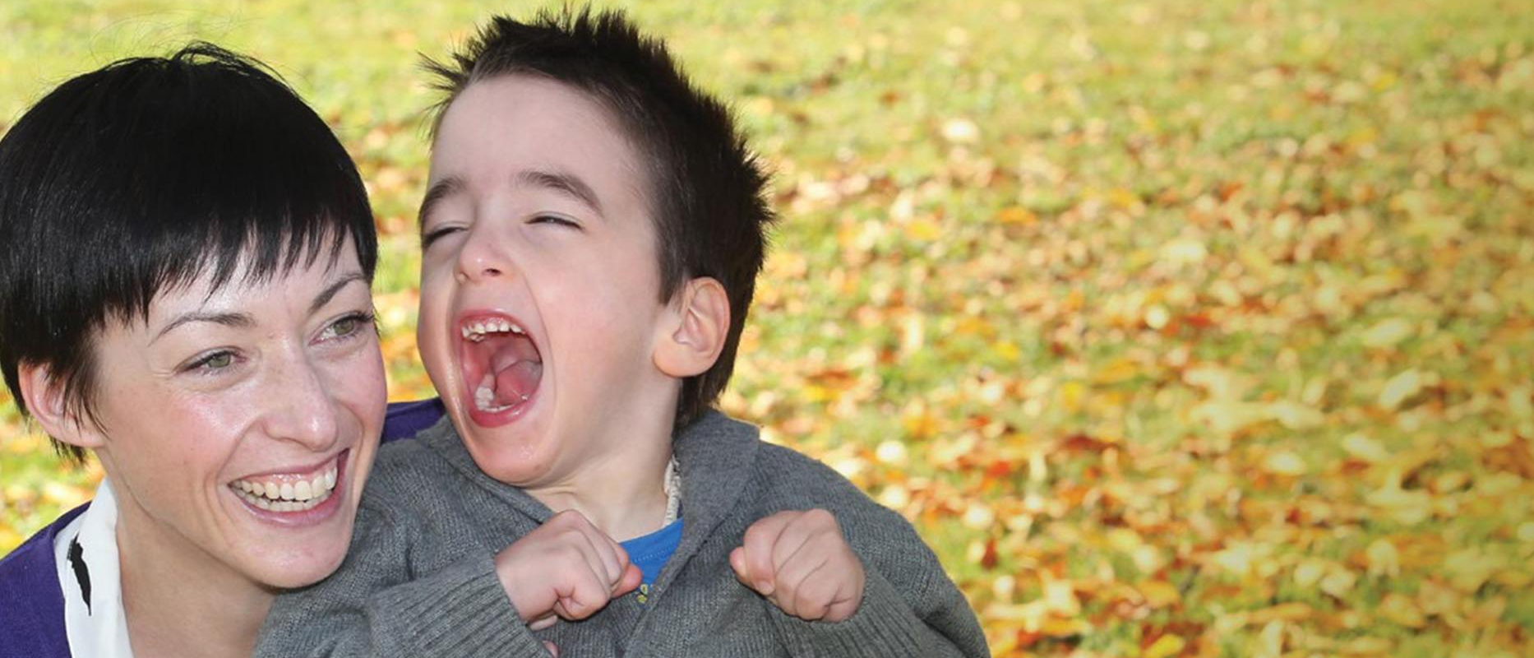
Free Oceania Academy Membership for Students
The Oceania Academy of Cerebral Palsy and other Childhood-onset Disabilities (Oceania Academy) aims to provide opportunities for connection, learning, and advocacy towards meaningful participation and improved quality of life for and with people with cerebral palsy and other childhood-onset disabilities across the lifespan.
The Oceania Academy Board is offering free one year of membership to students in ‘entry to practice’ degrees, including undergraduate and graduate entry courses such as allied health or medical degrees. Higher research degrees such as a M-Phil or PhD, or post-graduate specialisation degrees are not eligible.
Email info@oceaniaacademy.org with a copy of your student enrolment to sign up.
Membership includes:
Opportunity to connect with Academy members
Discounted registration for the Oceania Academy conference
Unrestricted access to the member-only part of the Oceania Academy website which includes educational material and podcasts
Opportunity to join committees that undertake many of the Academy’s activities. Additional benefits for people with lived experience who join an Oceania Academy committee include free registration at biennial Oceania Academy conferences, free membership of the Oceania Academy and an honorarium of $500 per year.
Quarterly e-newsletter with Academy updates, research findings and opportunities
https://www.oceaniaacademy.org

